Slide 1




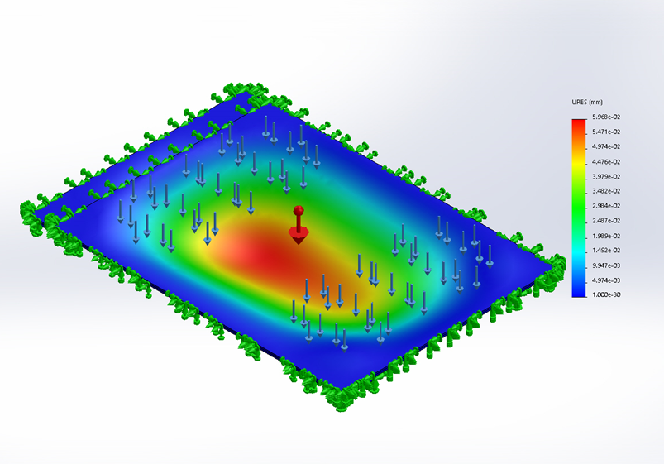
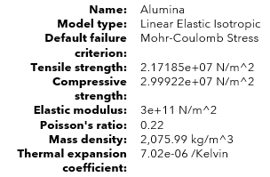
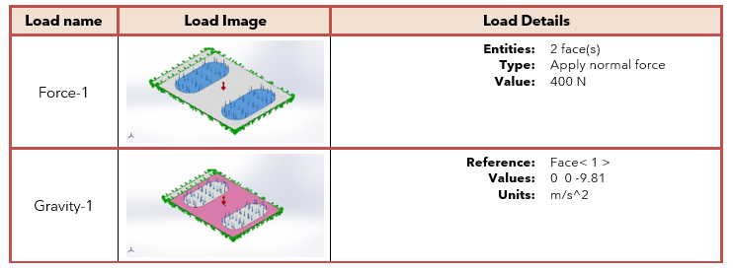
LOAD VALIDATION
FEA ANALYSIS
AIAA Caltech Student Branch – 11/181/20
Preliminary Design Review – EASE
Displacement Plot
Maximum Displacement: 0.0597 mm

Slide 2
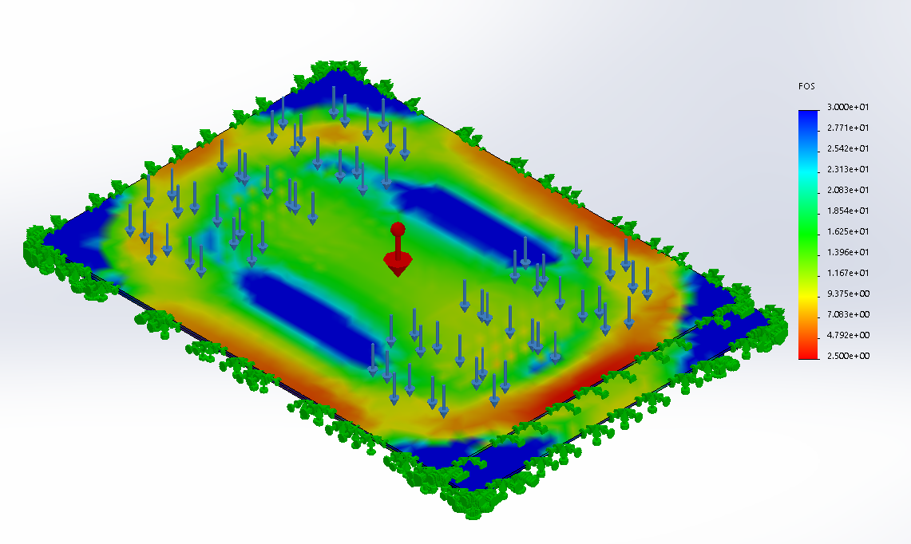
LOAD VALIDATION
FEA ANALYSIS
AIAA Caltech Student Branch – 11/181/20
Preliminary Design Review – EASE
Factor of Safety Plot
Minimum FOS: 2.67
(Load includes a 1.5 FOS already, so there is room for mass reduction)

